Slide 1
Unit 1-1
Points, Lines, And Planes
PLANE Geometry

Slide 2
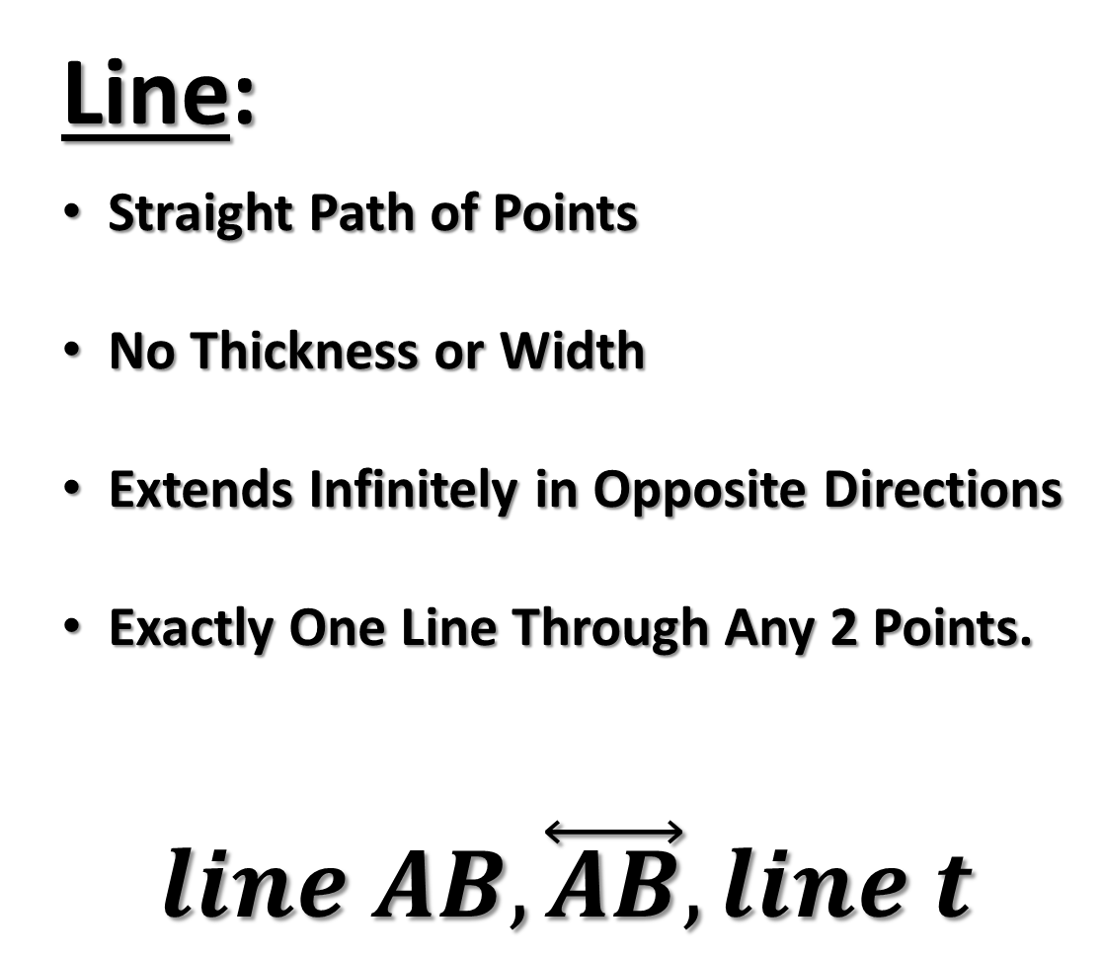
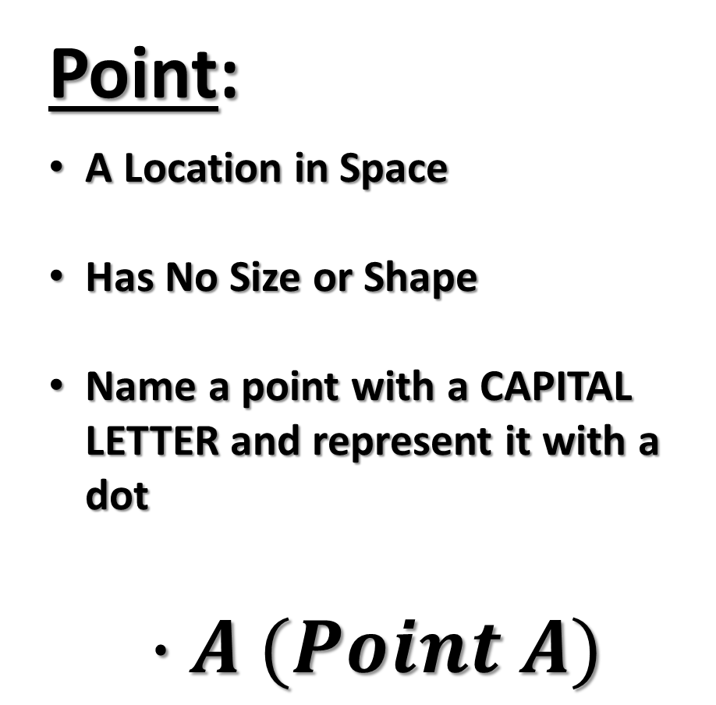
Point:
A Location in Space
Has No Size or Shape
Name a point with a CAPITAL LETTER and represent it with a dot
$$∙A (Point A)$$
Line:
Straight Path of Points
No Thickness or Width
Extends Infinitely in Opposite Directions
Exactly One Line Through Any 2 Points.
$$line AB, \overset{⃡}{AB},line t$$
t
A
B

Slide 3
Collinear:
Points that form a line.
Noncollinear:
Points do not form a line.
B
●
●
●
●
A
B
C
●
●
A
C

Slide 4
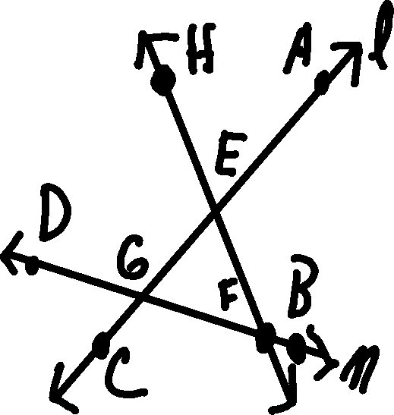
Example 1
Are the following points collinear?
  A, E, C
  G, F, B
  D, E, A
Name line m in three other ways
Name line l in three other ways

Slide 5
PLANE
Flat Surface/No Thickness
Infinite Number of Points and Lines
Extends Without End
Any 3 Noncollinear Points ALWAYS Make a Plane
Name a Plane
  A Capital Letter or
  At Least 3 of its Noncollinear Points
R . S .
T .
Plane RST or Plane X
X

Slide 6
COPLANAR
Lines or points in the same plane
R . S .
T.
X

Slide 7
Example 2
NAME THE PLANE
The Bottom
The Top
The Front
The Back
The Left Side
The Right Side
A
B
D
C
E
F
H
G

Slide 8
Through any 2 points there is exactly one line.
A
B
t
Line t is the only line that passes through points A and B.
Two lines intersect in exactly one point.
Lines m and n intersect at point P.
●
P
m
n

Slide 9
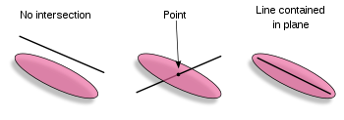
A line and a plane intersect, in exactly one point.

Slide 10
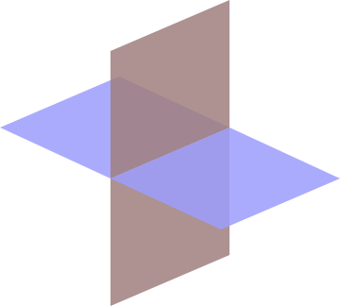
Plane ABC and Plane D
intersect at line t.
Two planes intersect, in exactly one line.
●A
●B
●C
D
t

Slide 11
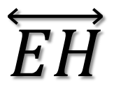
Example 3)
Name the intersection of Planes ABC & BFG
A
B
D
C
Name two planes that intersect the given line.
E
$$\overset{⃡}{EH}$$
F
H
G

Slide 12
Example 4
NAME A POINT THAT IS COPLANAR WITH THE GIVEN POINTS:
A) Points A, B, and C
B) Points E, F, and G
C) Points C, F, and G
D) Points A, C, and G
A
B
D
C
E
F
H
G

Slide 13
Example 5
A
B
Shade the plane containing points A, E, F
Name another point in Plane EHG
Is point F coplanar with plane DCG?
D
C
E
F
H
G

Slide 14
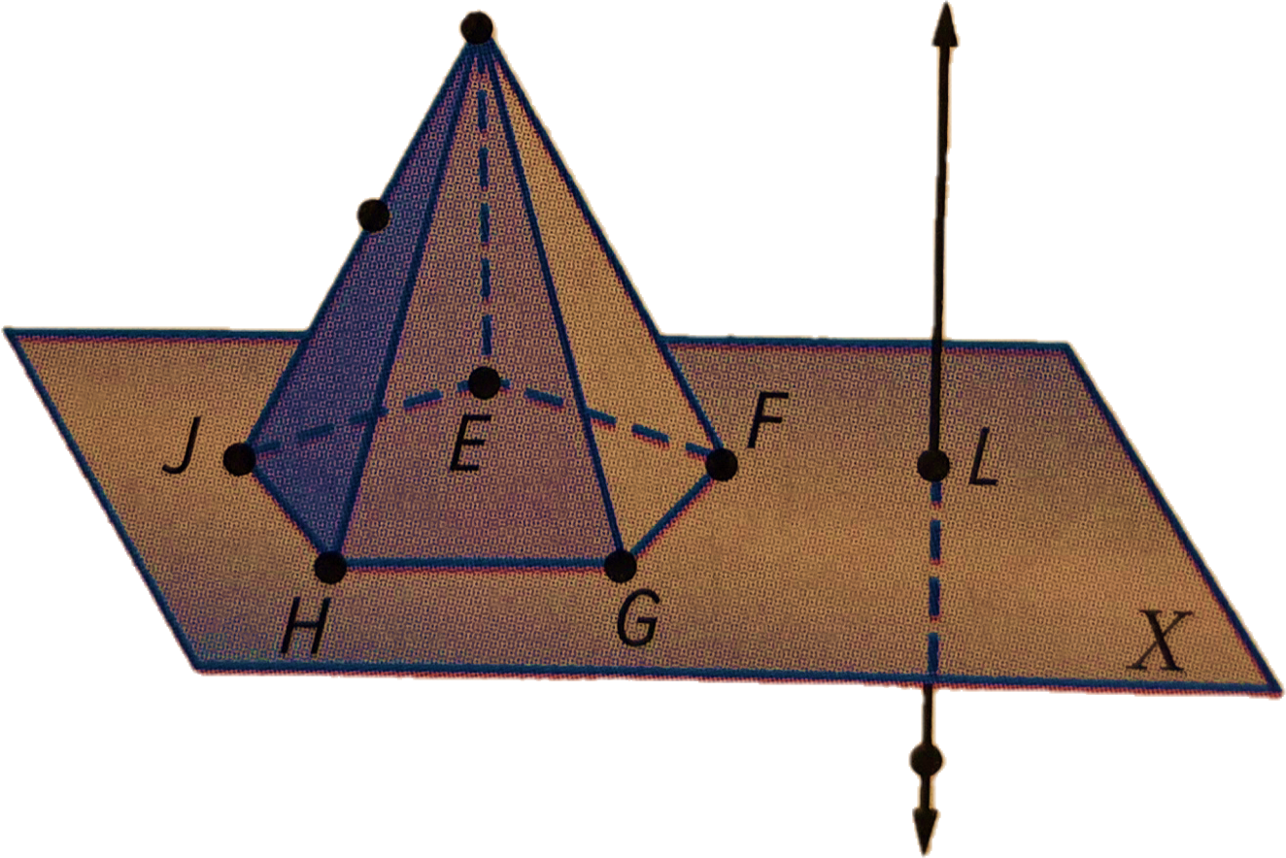
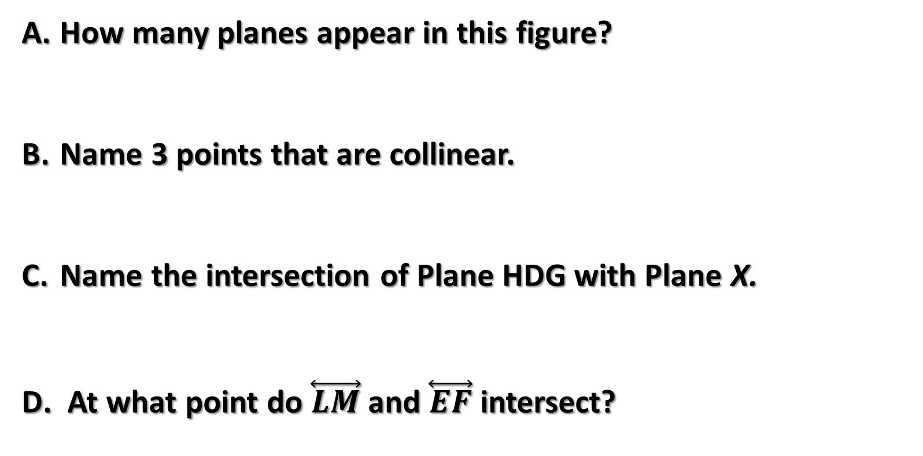
Example 6
D
K
How many planes appear in this figure?
Name 3 points that are collinear.
Name the intersection of Plane HDG with Plane X.
At what point do $\overset{⃡}{LM}$ and $\overset{⃡}{EF}$ intersect?
M

